Slide 1

Game of Life
Rajankumar Mandanka
Marwadi University

Slide 2

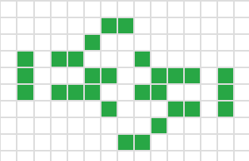
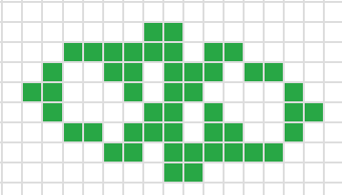
What is Conway's Game of Life?
Introduction:-
Created by John Conway in 1970.
A cellular automaton that simulates "life" on a grid.
Objective: Observe how simple rules lead to complex patterns.

Slide 3





How It Works
Rules of the Game
Any live cell with 2 or 3 live neighbors survives.
Any dead cell with exactly 3 live neighbors becomes alive.
All other live cells die, and dead cells remain dead.

Slide 4





Features of the Game
Key Features :-
No players; the game evolves automatically.
Infinite variations based on initial configuration.
Patterns :-
Still lifes: Do not change over generations.
Oscillators: Repeat a pattern periodically.
Spaceships: Move across the grid.

Slide 5
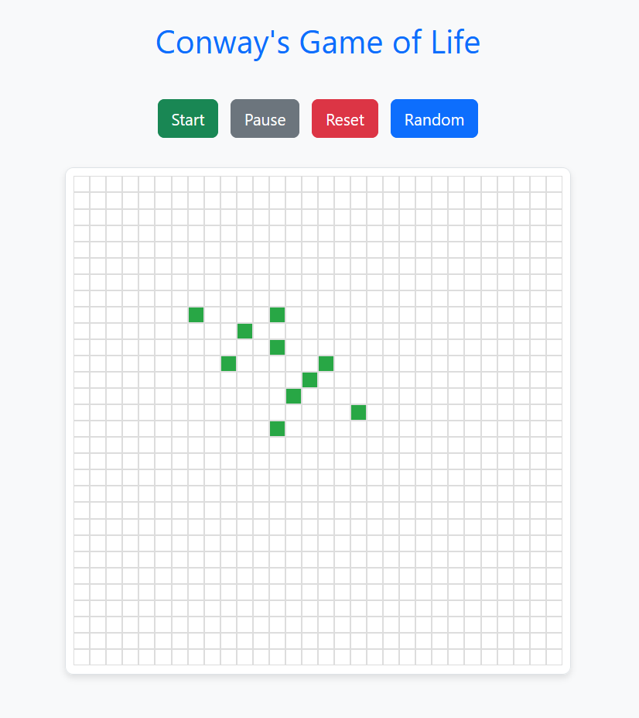
Project Overview
Technologies Used:
HTML: For grid layout.
Bootstrap & css: For styling and controls.
JavaScript: For game logic.
Features:
Toggle cells (alive/dead).
Start, pause, reset, and randomize controls.
Dynamic grid updates based on rules.

Slide 6
How It’s Implemented
Implementation Steps :-
Create the Grid: A 2D grid of cells (div elements).
Handle User Input: Toggle cell state by clicking.
Game Logic:
Count live neighbors for each cell.
Apply rules to compute the next generation.
Grid Updates: Update grid dynamically using JavaScript.
Controls: Buttons for Start, Pause, Reset, Randomize.

Slide 7

Challenges Faced
Challenges and Solutions :-
Challenge: Efficiently updating a large grid.
Solution: Used a 2D array and optimized loops.
Challenge: Creating dynamic controls.
Solution: Added event listeners to buttons.
Challenge: Ensuring accurate rule implementation.
Solution: Debugged with console logs and test patterns.

Slide 8
Lessons Learned
What I Learned
Practical use of JavaScript for interactive UI.
Styling with Bootstrap for responsive design.
Problem-solving skills for debugging grid logic.

Slide 9
Conclusion
Conway's Game of Life demonstrates how simple rules can create complex systems.
Programming it helped enhance my understanding of grid-based logic and JavaScript.

Slide 10
Thank you

